Slide 1
Atrial Fibrillation
DR. DAYANAND NAIK, MD, FACC;
CLINICAL associate professor,
New york medical college.

Slide 2
Objectives
Introduction & Definitions
Epidemiology and Risk Factors
Classification of Atrial Fibrillation
Evaluation & Diagnostics
Treatment
New Onset vs. Long-standing

Slide 3
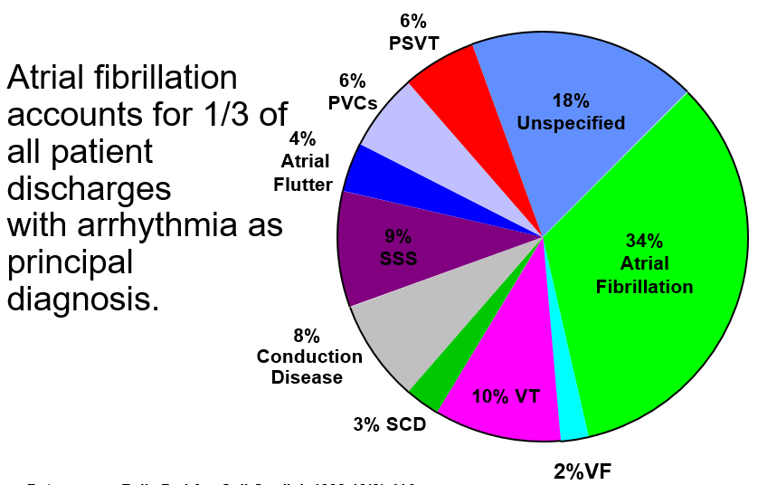
Introduction
Atrial Fibrillation is the most common cardiac arrhythmia
Definition:
Irregularly Irregular rhythm
R-R intervals that follow no repetitive pattern
No distinct p-waves

Slide 4
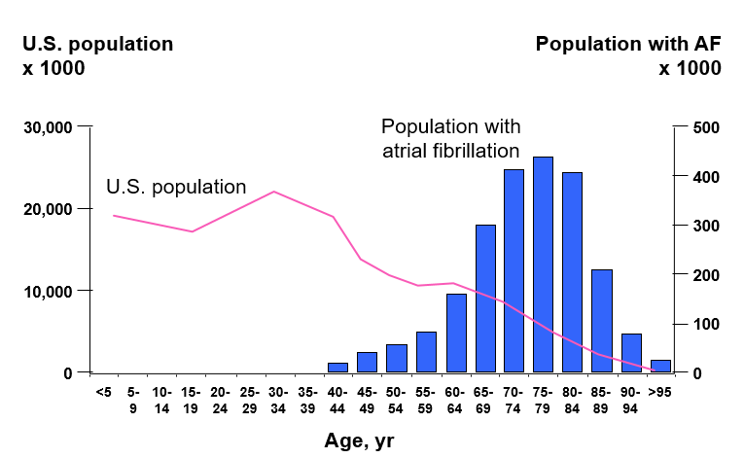
Epidemiology
Global healthcare problem with over 30 million patients affected
Approximately 5 million new cases per year
In the United States, ATRIA study estimated that 2.3 million adults had A-Fib; expect the number to increase to 5.6 million by 2050
25% of individuals aged 40 or older will develop A-Fib in their lifetime
Whites are at higher risk of developing A-Fib than Blacks or Hispanics

Slide 5
Risk Factors: Cardiac
Hypertensive Heart Disease
Coronary Heart Disease
Rheumatic Fever
Valvular Heart disease
Heart Failure
Hypertrophic Cardiomyopathy
Congenital Heart disease (ie. ASD, PDA, TOF, etc.)
Most Common Underlying chronic disorders in developed countries
Associated with much higher incidence in Undeveloped countries

Slide 6
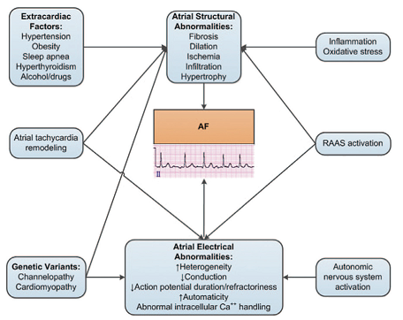
Risk Factors: Non-cardiac
Pulmonary
Pneumonia
COPD
Pulmonary Embolism
Hyperthyroidism
Diabetes/Obesity
Chronic Kidney disease
Drug & Alcohol use

Slide 7
Classification of Atrial Fibrillation
Historically, the terms “acute” and “chronic” atrial fibrillation were used to described the nature of a patient’s A-Fib
These terms have been replaced with the following classification schema as per the 2014 American Heart association/College of Cardiology:

Slide 8
Classification of Atrial Fibrillation
Lone Atrial Fibrillation:
Common in patients <60 years old
No underlying cause
Usually asymptomatic or with mild symptoms
Normal heart structure
No associated co-morbidities with low risk of further complications
Generally have a CHADS2 score of “0”
Some hereditary component

Slide 9
Evaluation: Initial Findings
Typical Presentation:
Palpitations
Tachycardia
Fatigue, Weakness & Dizziness
Lightheadedness
Reduced exercise capacity
Increased Urination
Mild Dyspnea
More severe symptoms include: Dyspnea at rest, Angina, Presyncope or Syncope, Embolic event

Slide 10
Evaluation: History & Physical Exam
Important questions to ask:
Onset or date of discovery
Frequency & Duration
Severity
Qualitative characteristics
Disease associations:
Risk factors & etiologies discussed earlier
Common precipitating causes to look for:
Exercise
Alcohol & Drug use
Strong emotions
Complete Examination of Cardiovascular System:
Note any murmurs, pain upon palpation, difficulty breathing, irregular pulses or radiating chest pain

Slide 11
Evaluation: Electrocardiogram
Common Findings:
Lack of discrete p-waves
Fibrillatory, or f-waves, present at a rate between 350-600 bpm; can vary in amplitude, morphology and interval
Ventricular response follows no repetitive pattern
Ventricular rate usually 90-170bpm
QRS complexes are narrow, unless AV conduction through Bundle of His is abnormal

Slide 12
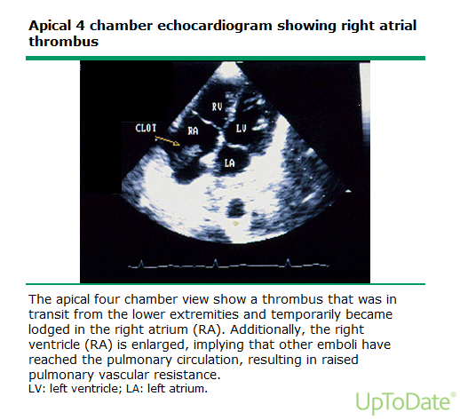
Evaluation: Echocardiogram
Useful in:
Assessment of cardiac chamber size and function, the pericardium and valvular function to help determine any conditions associated with A-Fib
Identifying patients at increased risk for thromboembolic complications of A-fib

Slide 13
Evaluation: Additional Testing
Exercise testing: may be useful for patients with signs or symptoms of ischemic heart disease
Can help guide pharmacotherapy for AF (some anti-arrhythmics are contraindicated in patients with CAD)
Holter monitoring:
If A-fib is intermittent and not captured on routine ECG
Helpful in assessing overall ventricular response rates
Testing for clinical or subclinical Hyperthyroidism
CBC, Serum Creatinine, Analysis for proteinuria and testing for DM
Drug/Alcohol testing may be indicated in some patients

Slide 14
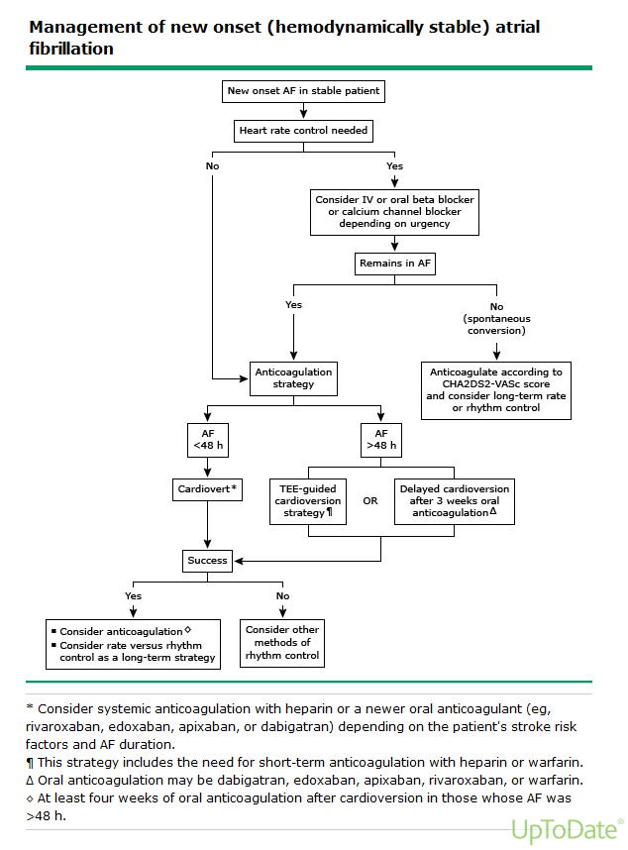
Treatment: New Onset Atrial Fibrillation
***In hemodynamically Unstable patients (HYPOTENSIVE, HF, Chest Pain, Syncope) immediate DC cardioversion is required FIRST

Slide 15
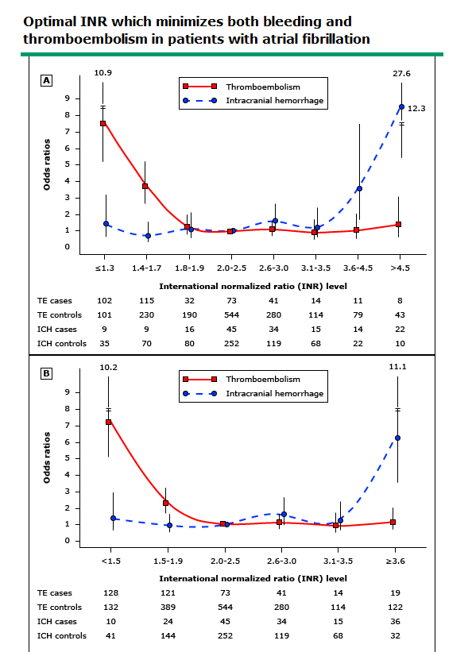
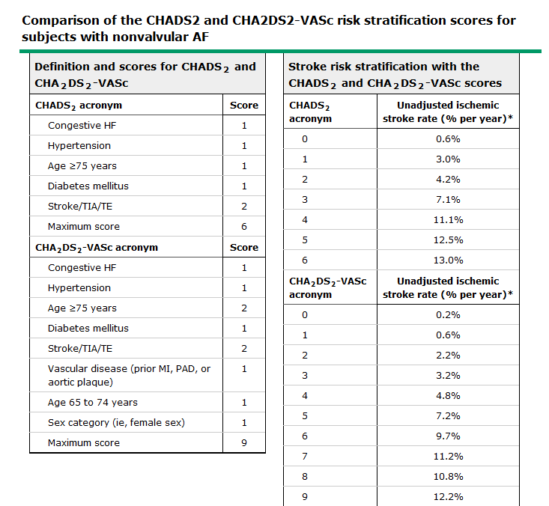
Treatment: Use of Anticoagulants
Stroke Risk is significantly elevated in patients w/ A-Fib
Risk of silent cerebral ischemia is also significantly elevated

Slide 16
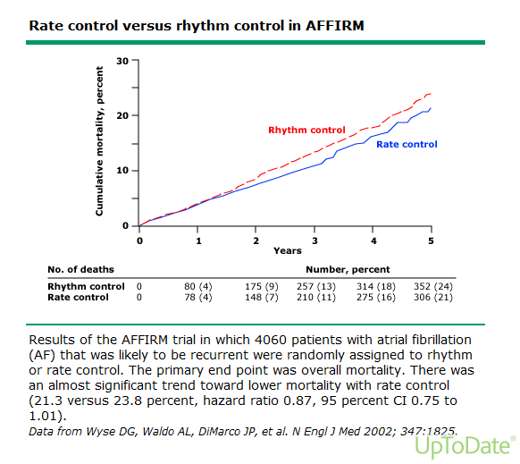
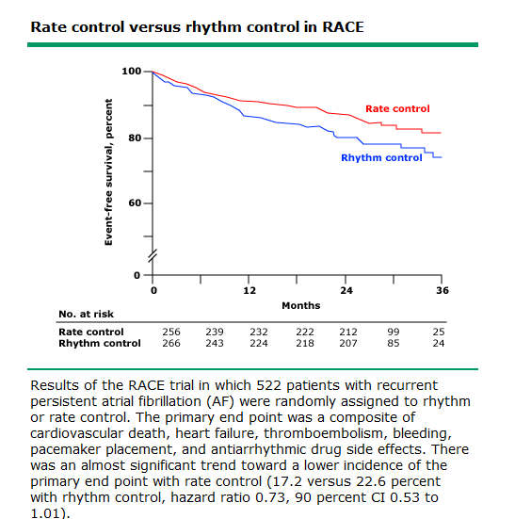
Treatment: Rate vs Rhythm Control
Rate control is the preferred therapy in patients:
Age >65
Asymptomatic/mildly symptomatic
Hypertensive
Recurrent A-Fib
The results from AFFIRM and RACE show equivalent and perhaps better outcomes with rate control than rhythm control, with fewer adverse effects

Slide 17
Treatment: Rate vs. Rhythm Control
Rate Control Agents
Beta Blockers
1st line therapy in both acute and chronic setting
More effective than CCB’s during exercise
CCB’s
1st line therapy in both acute and chronic setting
Digoxin
Generally reserved for those whose rate has not been adequately controlled with BB’s and/or CCB’s
Given more consideration in pt’s with LVF
Amiodarone
2nd line therapy for chronic rate control only when other therapies are unsuccessful or contraindicated

Slide 18
Treatment: Rate vs. Rhythm Control
•Class I refers to conditions for which there is evidence or general agreement that a given procedure or treatment is useful and effective.
•Class III refers to conditions for which there is evidence and/or general agreement that the procedure or treatment is not useful/effective and may be harmful
•Class II falls somewhere in between

Slide 19
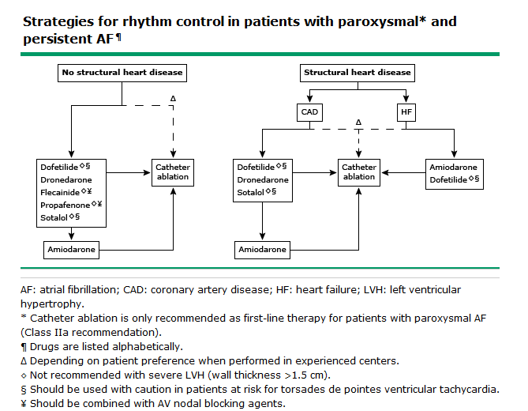
Treatment : Rate vs Rhythm Control
Rhythm control is preferred therapy in patients:
Failure of Rate control
Ie. Symptomatic patients or patients requiring optimal cardiac performance
<65 years old
Unable to take anticoagulants

Slide 20
Treatment: Paroxysmal, Persistent, Longstanding or Permanent Atrial Fibrillation
Suggest routine follow-ups every 12months in stable patients and every 6months in patients on high-risk antiarrhythmic therapy (ie. Dofetilide, Sotalol)
Routine Care:
Check efficacy and safety of antithrombotic therapy (INR & Creatinine clearance)
Assess for any changes in functional status
Check efficacy and safety of antiarrythmic drug therapy
Check rate control (History & ECG)

Slide 21
Treatment : Use of anticoagualants – Risk stratification .

Slide 22
Newer anticoagulantas

Slide 23
Warfarin – Advantages and Disadvantages

Slide 24
Newer oral anticoagulants.

Slide 25
Dabigatran vs Warfarin

Slide 26
RECOVER STUDY

Slide 27
Dabigatran- Indications.

Slide 28
Xarelto

Slide 30
Rivaroxaban

Slide 31
Rivaroxaban

Slide 32
Apixaban vs Warfarin .

